Slide 1

Housekeeping
Module 9 – Sharing
Please mute yourself if you are not speaking.
Feel free to include your pronouns in your Zoom Name.
Use Zoom reaction tools, chat box, hands up, etc.
Be prepared to have video on at all times; as such, please be appropriately dressed and limit distractions.
Contribute to the conversations out loud and in the chat box.
If someone has already shared what you were going to say, lower your hand and put “agree” in the chat.
Notes:
COORDINATOR
Read out Housekeeping slide.

Slide 2
Expectations
Module 9 – Sharing
Arrive on time.
Help us create a confidential, non-judgmental space (no screenshots or recordings).
Please keep your phones on silent.
Avoid cross-talk and side-talk.
Learn from each person’s perspective.
Language – please bring new language to us as we recognize that language is ever-changing.
Have fun!
From the group:
[ADD PARTICIPANT ADDITIONS, IF ANY]
Notes:
COORDINATOR
Read out Expectations slide.

Slide 3
Core Connecting Skills: Sharing
Module 9
Notes:
Trainer Manual
Module 09: Sharing: A Core Peer Support Skill © 2023 PeerWorks
This training program is designed to be accessible to all trainers, and ensure that all participants receive the same quality of education regardless of specific trainers’ background and experience.
This manual is a living document and should be understood as a set of guidelines, not as a fixed script. Feel free to adapt the language to your style of presentation. We also recognize that language is always changing; please update terminology when necessary. The synchronous sessions should be dynamic, engaging experiences.
TRAINER
Welcomes everyone and states the topic of today’s module.

Slide 4
Land Acknowledgement
Module 9 – Sharing
I am speaking to you today from Toronto. Toronto is in the 'Dish With One Spoon Territory’. The Dish With One Spoon is a treaty between the Anishinaabe, Mississaugas and Haudenosaunee that bound them to share the territory and protect the land. Subsequent Indigenous Nations and peoples, Europeans and all newcomers have been invited into this treaty in the spirit of peace, friendship and respect.
The "Dish", or sometimes it is called the "Bowl", represents what is now southern Ontario, from the Great Lakes to Quebec and from Lake Simcoe into the United States. *We all eat out of the Dish, all of us that share this territory, with only one spoon. That means we have to share the responsibility of ensuring the dish is never empty, which includes taking care of the land and the creatures we share it with. Importantly, no knives are at the table, representing that we must keep the peace.
We want to acknowledge and respect all Indigenous people who don’t live in their traditional territories but have made a home in different parts of Ontario and have brought their culture with them.
Notes:
COORDINATOR
Read out PeerWorks’ land acknowledgement.

Slide 5

Icebreaker Activity
Module 9 – Sharing
What is your name?
If you had to rename yourself, what name would you choose?
Notes:
TRAINER
“If you had to rename yourself, what name would you choose?”
As the trainers, feel free to go first. Keep it brief and thank people for sharing. People often associate meals with the culture and community. This question is a way to have us reflect on the self-care we are implementing in our everyday life.

Slide 6
Module Overview
Module 9 – Sharing
In Module 9, we will continue to develop communicative listening skills through Sharing. We will examine some sharing examples and discuss the benefits of different sharing styles.
We will practice sharing in small groups and reflect on our strengths and areas for further development.
Notes:
TRAINER
Read the Module Overview and Learning Objectives out loud or invite a participant to read it out loud.

Slide 7
Learning Objectives
Module 9 – Sharing
Through the successful completion of Module 9, you will be able to:
Describe the benefits of Sharing with a Peer.
Apply this Core Connecting Skill within a structured skills practice.
Assess your own and other’s ability to demonstrate the core connecting skill.
Notes:
TRAINER
Read the Module Overview and Learning Objectives out loud or invite a participant to read it out loud.

Slide 8
Recap Activity
Module 9 – Sharing
Explain the value of using open-ended questions, affirming responses, reflective listening, and summarizing (also known as OARS) in the Peer Support relationship.
E-mail your response to the trainers when you are done (part 1 of your homework). The purpose of this activity is to ensure that the important information has been clearly communicated, and to see if there are elements of listening that need to be reviewed.
Notes:
COORDINATOR
Read the instructions out to the participants. The purpose of the Recap Activity is to ensure that the participants understand how to apply the skills we discussed and practiced in the previous activity. This is more involved Recap than the previous one, and it should take approximately 10 minutes.
After everyone has submitted their Recap, discuss the activity. Was it fairly easy or were there things that participants found challenging?
At this point, you can also ask everyone how their Listening Practice session went and how it felt to practice Active Listening outside of the synchronous sessions.

Slide 9
Skilled Sharing
Module 9 – Sharing
Unlike spontaneous sharing, Skilled Sharing involves the Peer Supporter intentionally revealing an aspect of themselves, their experience, their perspective, and/or their Recovery story to a Peer.
Skilled Sharing within the Peer/Peer Supporter relationship is used purposefully and skillfully by the Peer Supporter in order to establish a rapport, find common ground, validate, encourage and inspire.
Notes:
TRAINER
Read out the slide or ask a participant to read it out.

Slide 10

Notes:
TRAINER
Introduce the video by saying that this is our first example of a Peer Support share. The video is of Bart Campbell, who works as a Peer Supporter. Ask the group “How does Bart’s video demonstrate skilled sharing?”

Slide 11
Guidelines for Skilled Sharing
Module 9 – Sharing
Seeking permission from the Peer before sharing.
Ensuring that the benefit of sharing with the Peer is clear.
Keeping your focus on the Peer as you share – It’s not all about you.
Sharing selective aspects and/or edited versions of your experience, perspective, and story.
Being in tune with the impact of sharing on self and the Peer. Checking in with your Peer.
Are there any more points you want to include in this list?
Notes:
TRAINER
This slide includes some Guidelines for Skilled Sharing. You can make it clear that these aren’t the only things to keep in mind, but that they are a great start. Then invite the group to add in anything else that they would like to include.
W.A.I.T—Why Am I Talking?
The purpose behind using this acronym is help support our peers in a 1:1 peer interaction. Remember that this 1:1 is for the peer to talk about how they are feeling as it is their time to share and speak. Before we fill the void of awkward silence, ask yourself W.A.I.T. As a peer we only share when it is relevant to share or illustrates a point.
Here is more information on using the W.A.I.T acronym.
Perhaps this could be added to the handbook or the trainer slides as a resource.
Am I talking for approval and to be overly helpful?
Am I talking to control and take charge of the situation?
Here are a few reflective questions to ask yourself before you leap into a conversation:
What is my intention behind what I am about to say?
What question can I ask that would help me better understand what the other person is saying?
Is my need to talk an attempt to divert the attention to me?
How might I become comfortable with silence rather that succumb to my urge to talk?
You should be halfway through the slides now.

Slide 12
Ineffective Ways of Sharing
Module 9 – Sharing
Sharing without seeking permission from the Peer.
Sharing when the intention or benefit to the Peer is unclear.
Focusing on the Peer Supporter – It’s all about me.
Sharing endless or repetitive stories
Sharing more of yourself than you are comfortable disclosing.
Competing with the Peer for airtime.
Joining the Peer in a negative downward spiral.
Are there any more points you want to include in this list?
Notes:
TRAINER
Similarly, the next slide is about “Ineffective Ways of Sharing.” Invite the group to add to the list. This might bring up discussions of past shares and things that have gone right and wrong.

Slide 13
Steps for Sharing
Module 9 – Sharing
Identifying Opportunities is recognizing possible moments to introduce an aspect of yourself, your experience, and or your perspective with a Peer.
Determining Intention is considering how sharing this aspect of yourself will benefit the Peer
Self Disclosing is revealing an aspect of yourself or your story to a Peer.
Notes:
TRAINER
*This slide is animated. Each of the 3 steps pops up on the slide one at a time.
Read the steps for sharing. If there is time—this will depend on how engaged the group was in the previous discussions—you can discuss how the shares we watched follow these steps.

Slide 14
Skills Practice Activity
Module 9 – Sharing
You are a Peer Supporter having a first meeting with a Peer. They are unsure about the benefits of Peer Support and are not certain it is worth their time to continue.
What do you share about the benefits of Peer Support? Practice sharing one of your own experiences with Peer Support to demonstrate its value.
Notes:
COORDINATOR
Introduce the skills practice activity. You should have 20-30 minutes to dedicate to this activity. This will be the main opportunity for skills practice in this module. Read out the directions and separate everyone in break-out rooms. Each group should have 2-3 people depending on how many people you have. If there are three people per group, the third person can be the timekeeper and third-person observer.
Before they begin, say:
“Before we start, take some time to prepare yourself and think of the shares that you have prepared for this class.
If you are starting as the Peer Supporter, take this time to remove internal and external distractions.
If you need to, take some time between shares.”

Slide 15
Reflection Activity
Module 9 – Sharing
Take this time to write down three points that came up during the feedback loop.
What was challenging about sharing?
What was effective?
What would you try to do the next time you share?
You will submit this to the Trainers. It is the second part of your homework reflection for this module.
Notes:
TRAINER
*Debrief with group before transitioning to the reflection activity
After the group comes back together. Invite people to share thoughts about the experience.
Then transition into the reflection activity. Hopefully, there will be 5-10 minutes where everyone can immediate reflect on the sharing experience and what they still need to develop.

Slide 16
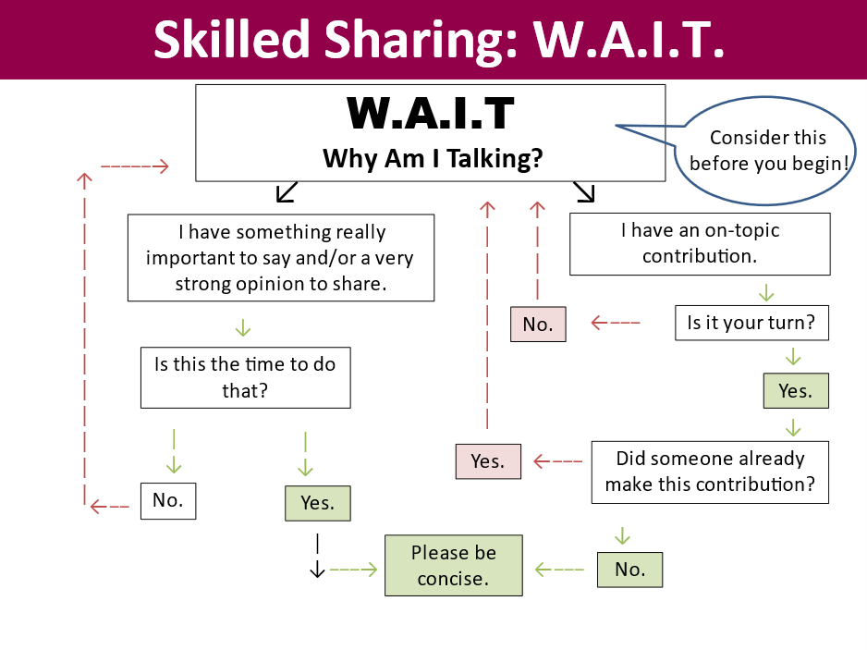
Resource
Module 9 – Sharing
Notes:
COORDINATOR
Read the resource listed on the slide

Slide 17
For Next Time
Module 9 – Sharing
Email parts 1 and 2 of your reflection to the Trainers:
Explain the value of using open-ended questions, affirming responses, reflective listening, and summarizing (also known as OARS) in the Peer Support relationship.
Following the skills practice/feedback loop activity, what was challenging about sharing? What was effective? What would you try to do the next time you share?
Watch Leah’s poetic share.
Notes:
COORDINATOR
Homework. Invite everyone to continue working on their responses for next time if they haven’t had enough time to answer all of the questions. The other part of the homework is to watch Leah’s share.

Slide 18
Thank You
Notes:
TRAINER
Thank everyone for their time and ask if anyone has any final comments or questions that they want to bring forward.

